Slide 1
Engineering Drawing & Graphics
Engineering Drawing & CAD
Lecture 05
Projection of Planes
by
Umer Farooq
April, 2019

Slide 2
PROJECTIONS OF PLANES
POSSIBLE POSITIONS
  With Respect to H.P.
    Parallel to the H.P.
    Perpendicular to the H.P.
    Inclined to the H.P.
  With Respect to V.P.
    Parallel to the V.P.
    Perpendicular to the V.P.
    Inclined to the V.P.

Slide 3
POSITIONS OF A PLANE WITH RESPECT TO THE TWO PLANES
Perpendicular to both planes
Parallel to one plane (must be perpendicular to the other plane)
    Parallel to the H.P. (must be perpendicular to the V.P.)
    Parallel to the V.P. (must be perpendicular to the H.P.)
Inclined to one plane and perpendicular to the other plane
    Inclined to the H.P. and perpendicular to the V.P.
    Inclined to the V.P. and perpendicular to the H.P.
Inclined to both planes (Oblique Planes)

Slide 4
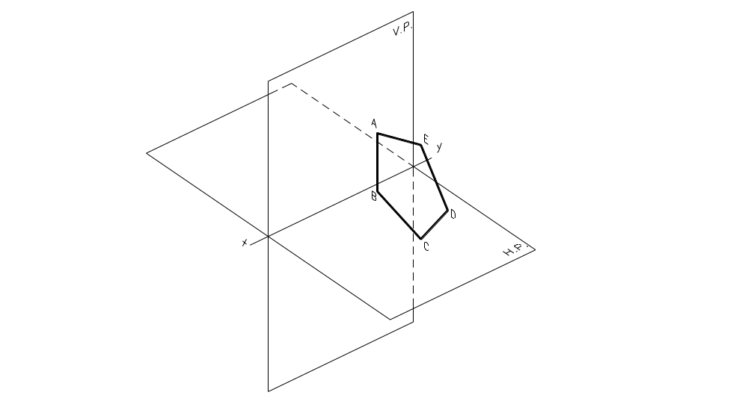
Perpendicular to Both Planes

Slide 5
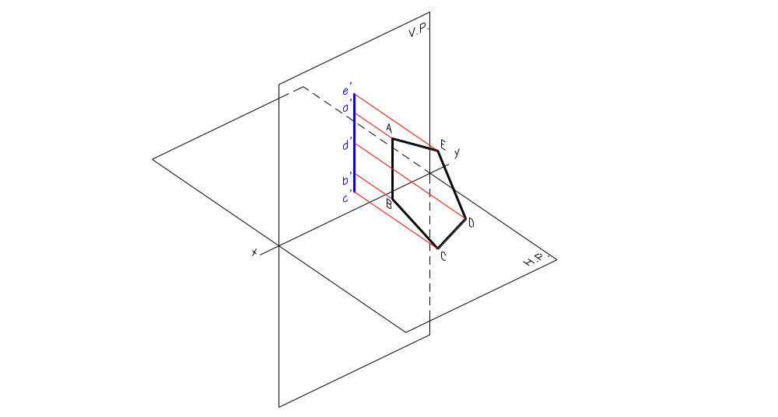
Perpendicular to Both Planes
  Front view is a line perpendicular to xy.

Slide 6
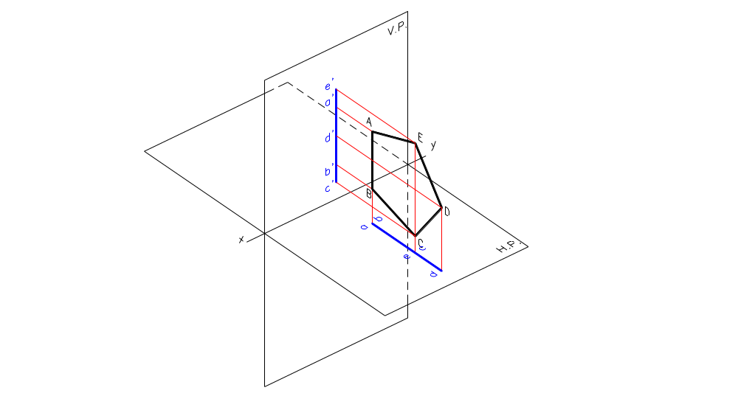
Perpendicular to Both Planes
  Front view is a line perpendicular to xy.
  Top view is a line perpendicular to xy.

Slide 7
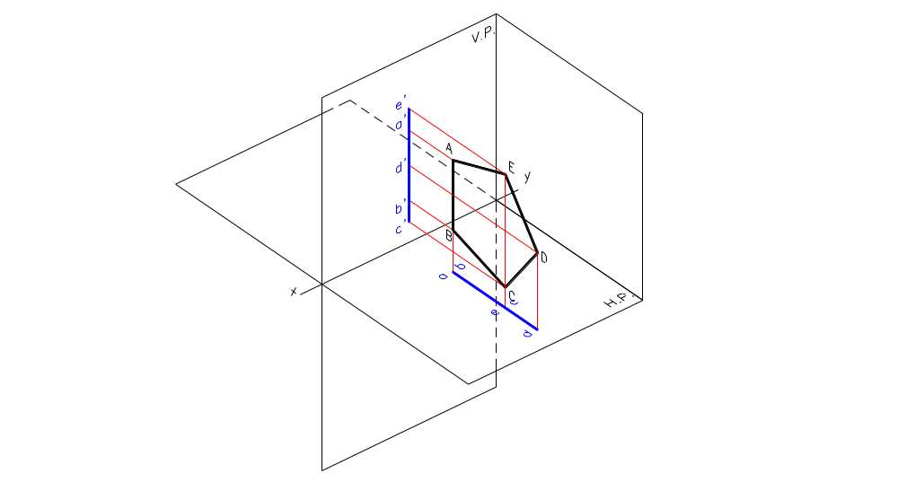
Perpendicular to Both Planes
  Front view is a line perpendicular to xy.
  Top view is a line perpendicular to xy.

Slide 8
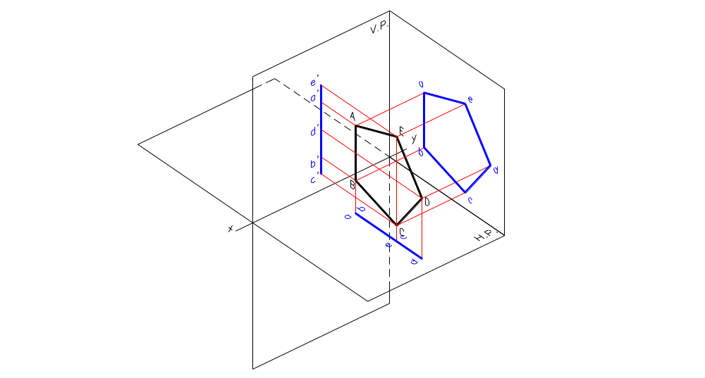
Perpendicular to Both Planes
  Front view is a line perpendicular to xy.
  Top view is a line perpendicular to xy.
  Side view is true size and shape and must be drawn first.

Slide 9
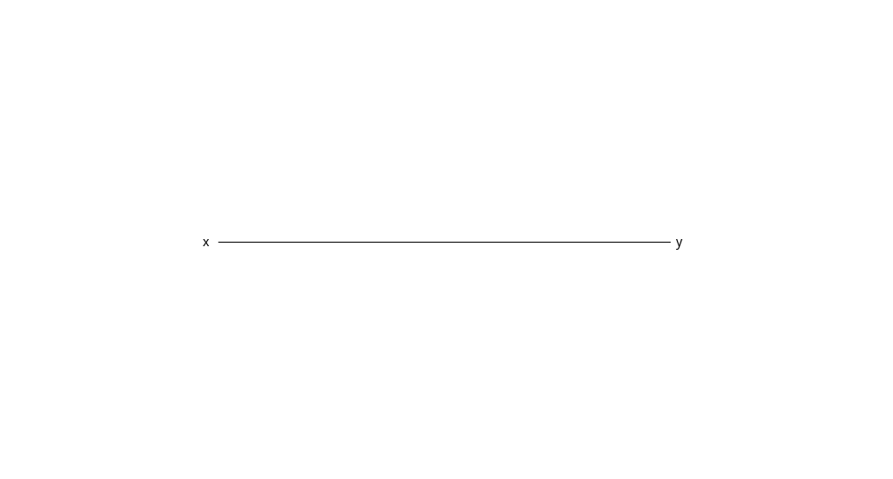
Example 1:
A regular pentagon of 50 mm side has its surface perpendicular to both planes. One side of the pentagon makes an angle of 30º with the V.P. Draw its projections.

Slide 10
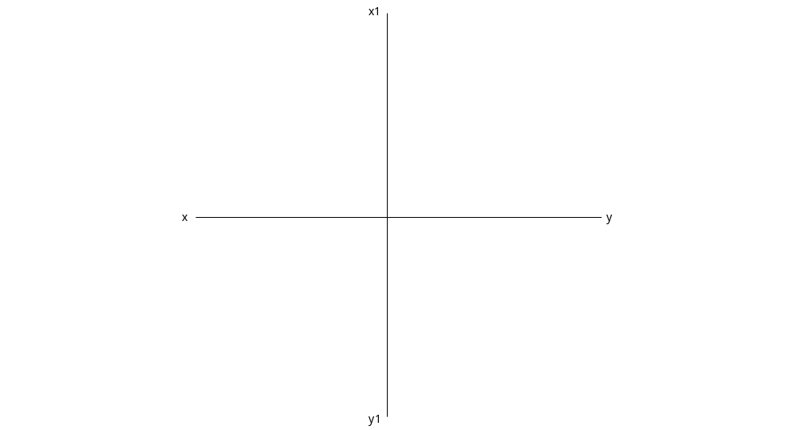
Example 1:
A regular pentagon of 50 mm side has its surface perpendicular to both planes. One side of the pentagon makes an angle of 30º with the V.P. Draw its projections.

Slide 11
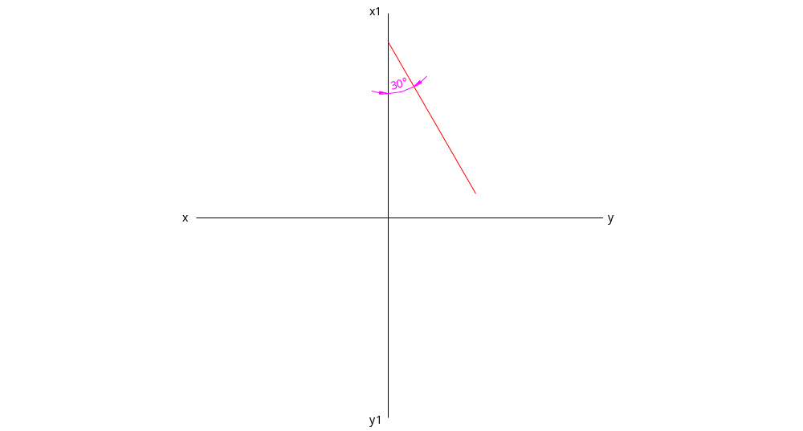
Example 1:
A regular pentagon of 50 mm side has its surface perpendicular to both planes. One side of the pentagon makes an angle of 30º with the V.P. Draw its projections.

Slide 12
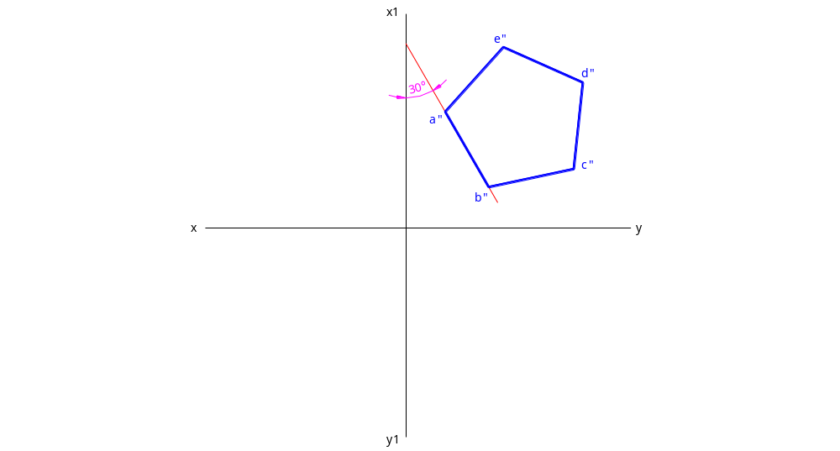
Example 1:
A regular pentagon of 50 mm side has its surface perpendicular to both planes. One side of the pentagon makes an angle of 30º with the V.P. Draw its projections.

Slide 13
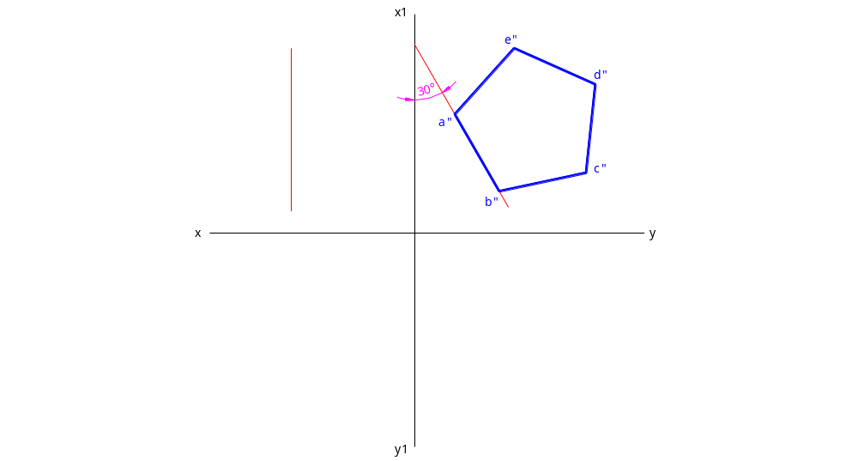
Example 1:
A regular pentagon of 50 mm side has its surface perpendicular to both planes. One side of the pentagon makes an angle of 30º with the V.P. Draw its projections.

Slide 14
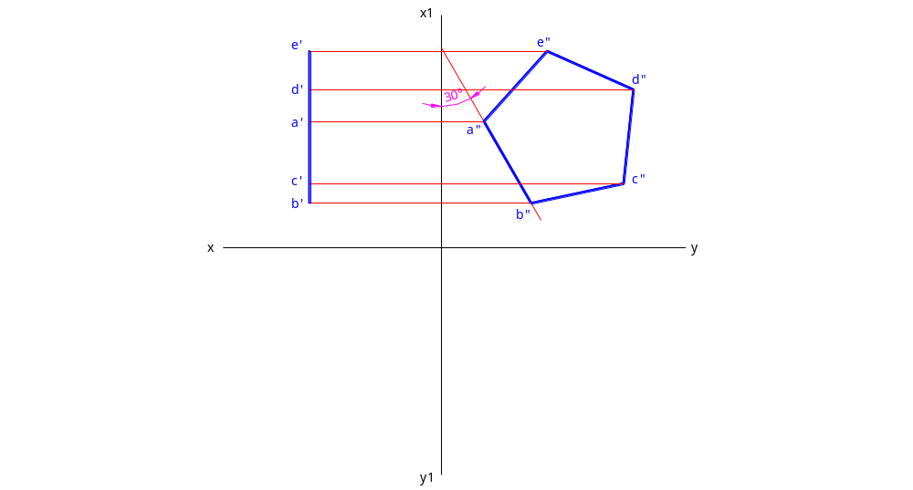
Example 1:
A regular pentagon of 50 mm side has its surface perpendicular to both planes. One side of the pentagon makes an angle of 30º with the V.P. Draw its projections.

Slide 15
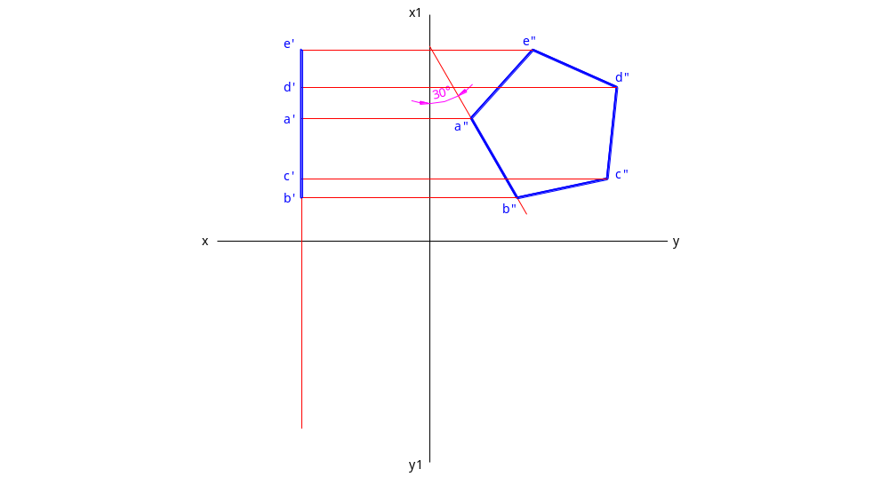
Example 1:
A regular pentagon of 50 mm side has its surface perpendicular to both planes. One side of the pentagon makes an angle of 30º with the V.P. Draw its projections.

Slide 16
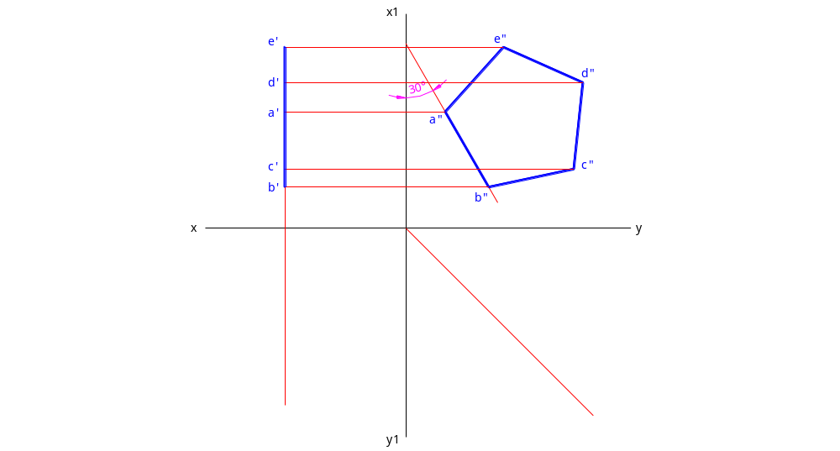
Example 1:
A regular pentagon of 50 mm side has its surface perpendicular to both planes. One side of the pentagon makes an angle of 30º with the V.P. Draw its projections.

Slide 17
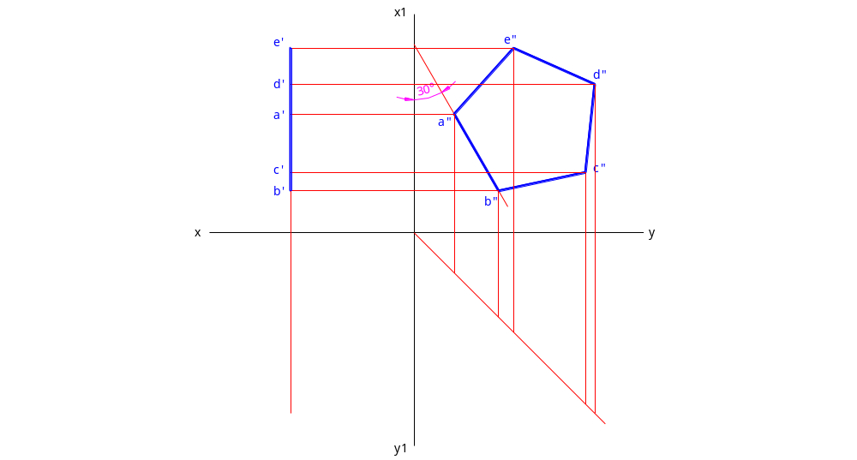
Example 1:
A regular pentagon of 50 mm side has its surface perpendicular to both planes. One side of the pentagon makes an angle of 30º with the V.P. Draw its projections.

Slide 18
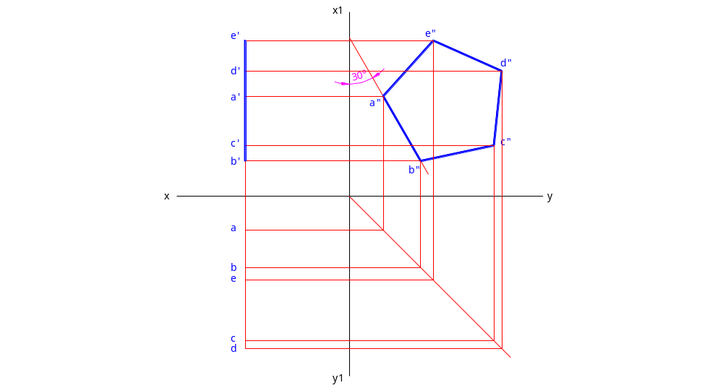
Example 1:
A regular pentagon of 50 mm side has its surface perpendicular to both planes. One side of the pentagon makes an angle of 30º with the V.P. Draw its projections.

Slide 19
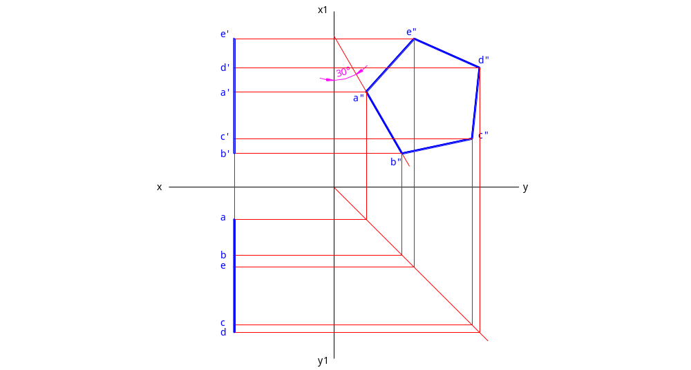
Example 1:
A regular pentagon of 50 mm side has its surface perpendicular to both planes. One side of the pentagon makes an angle of 30º with the V.P. Draw its projections.

Slide 20
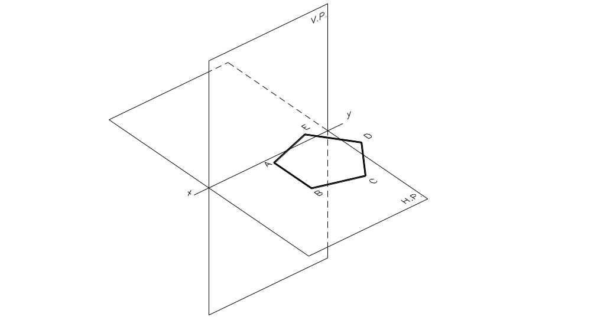
Parallel to H.P.

Slide 21
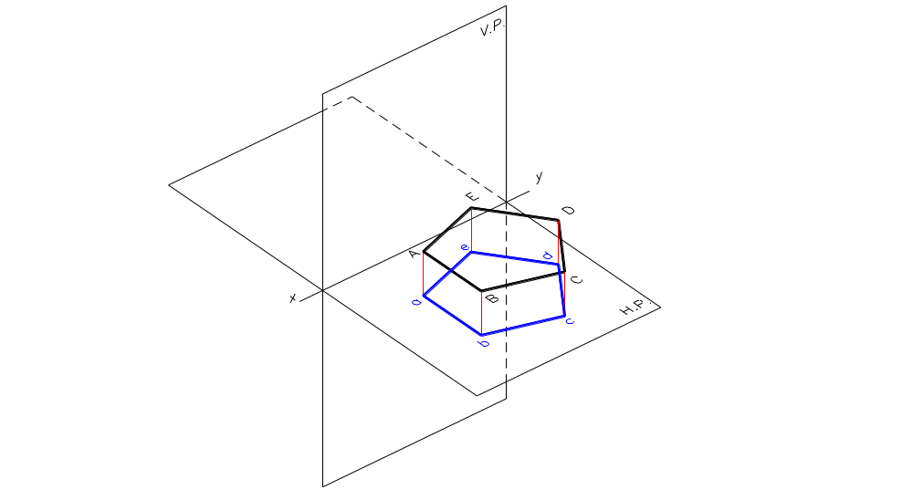
Parallel to H.P.
  Top view is True size and shape and shall be drawn first.

Slide 22
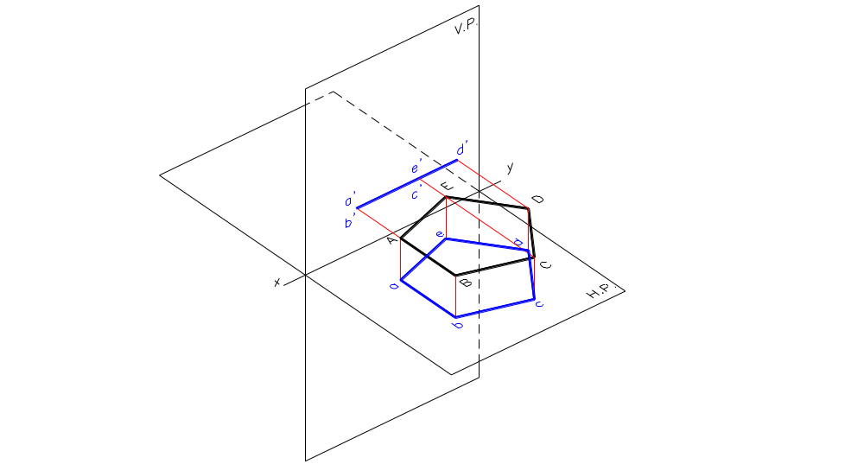
Parallel to H.P.
  Top view is True size and shape and shall be drawn first.
  Front view is a straight line parallel to xy.

Slide 23
Example 2:
A regular pentagon of 50 mm side has its surface parallel to the H.P. and 20 mm above it. One side of the pentagon is perpendicular to the V.P. Draw its projections.

Slide 24
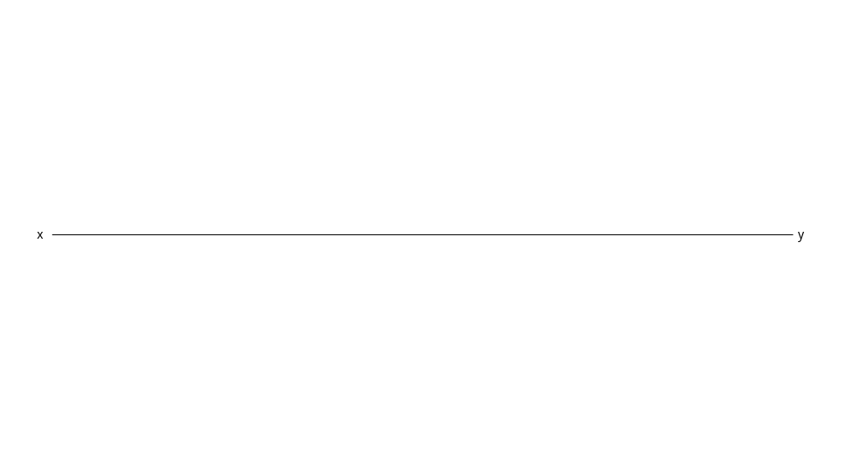
Example 2:
A regular pentagon of 50 mm side has its surface parallel to the H.P. and 20 mm above it. One side of the pentagon is perpendicular to the V.P. Draw its projections.

Slide 25
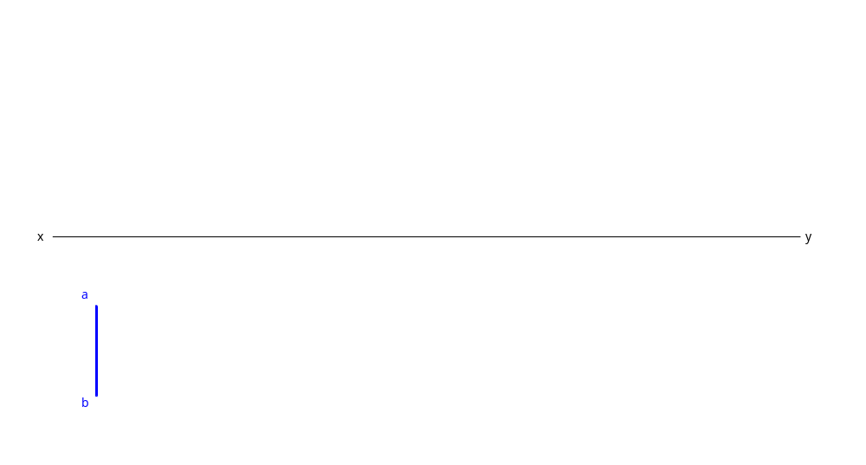
Example 2:
A regular pentagon of 50 mm side has its surface parallel to the H.P. and 20 mm above it. One side of the pentagon is perpendicular to the V.P. Draw its projections.

Slide 26
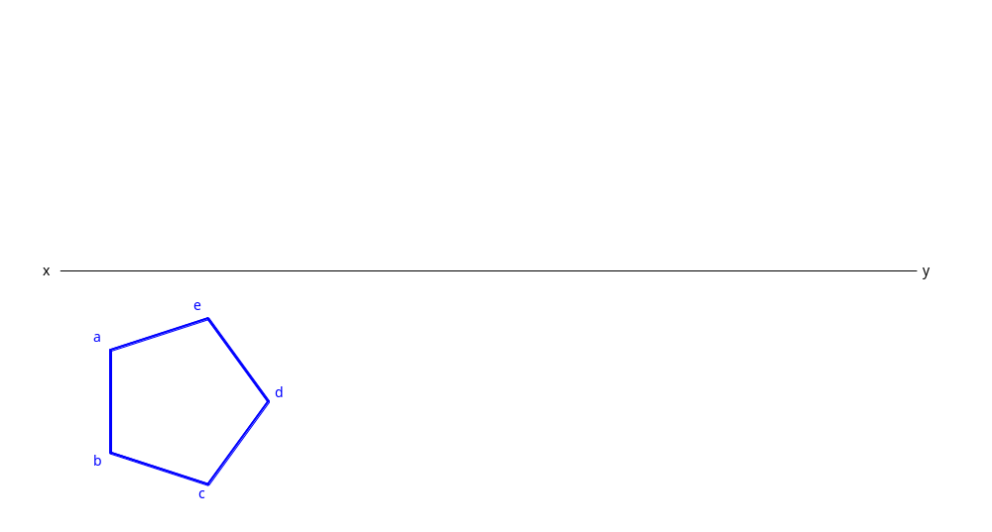
Example 2:
A regular pentagon of 50 mm side has its surface parallel to the H.P. and 20 mm above it. One side of the pentagon is perpendicular to the V.P. Draw its projections.

Slide 27
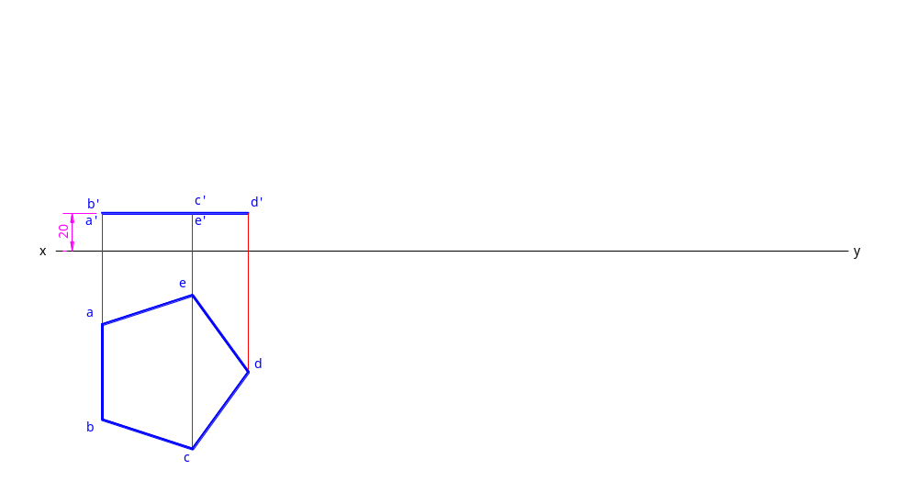
Example 2:
A regular pentagon of 50 mm side has its surface parallel to the H.P. and 20 mm above it. One side of the pentagon is perpendicular to the V.P. Draw its projections.

Slide 28
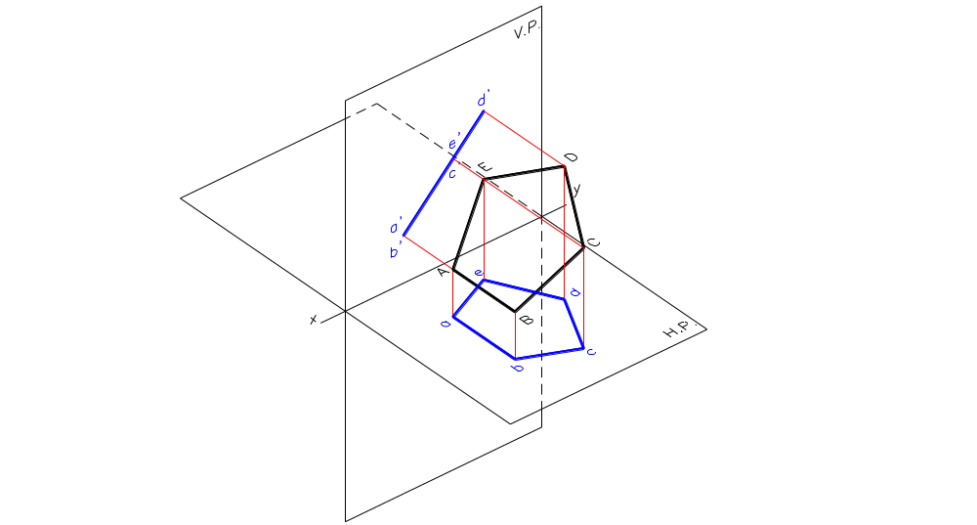
Inclined to the H.P. and Perpendicular to the V.P.
  Top view is a deformed shape
  Front view is a straight line inclined to the xy.

Slide 29
Assume the plane to be parallel to H.P. initially
  Top view will become True size and shape and shall be drawn first.
  Front view is a straight line parallel to xy, the length of which will be the final length of front view.

Slide 30
Example 3:
A regular pentagon of 50 mm side has its surface inclined to the H.P. at 45º and perpendicular to the V.P. One side of the pentagon is parallel to the H.P. and 30 mm above it. Draw its projections.

Slide 31
Example 3:
A regular pentagon of 50 mm side has its surface inclined to the H.P. at 45º and perpendicular to the V.P. One side of the pentagon is parallel to the H.P. and 30 mm above it. Draw its projections.

Slide 32
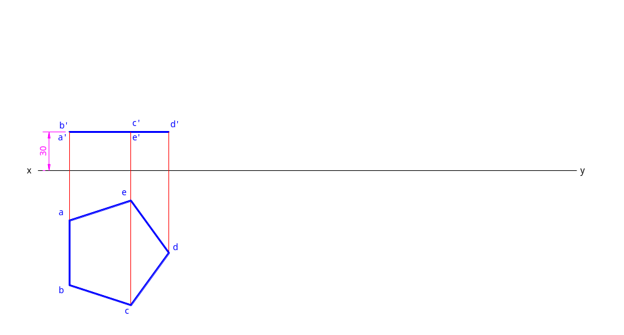
Example 3:
A regular pentagon of 50 mm side has its surface inclined to the H.P. at 45º and perpendicular to the V.P. One side of the pentagon is parallel to the H.P. and 30 mm above it. Draw its projections.

Slide 33
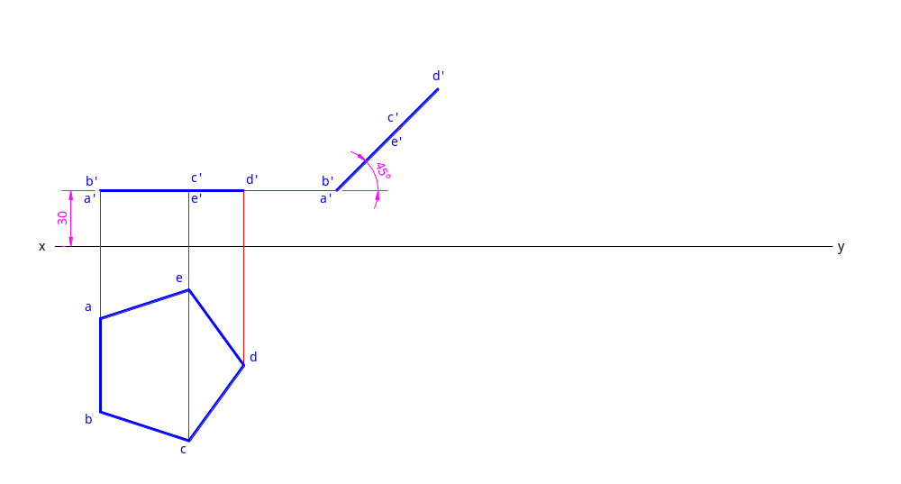
Example 3:
A regular pentagon of 50 mm side has its surface inclined to the H.P. at 45º and perpendicular to the V.P. One side of the pentagon is parallel to the H.P. and 30 mm above it. Draw its projections.

Slide 34
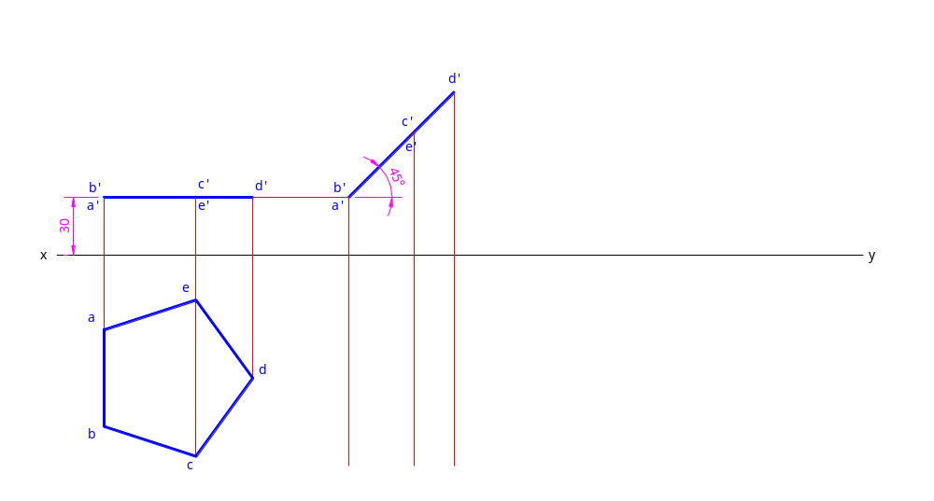
Example 3:
A regular pentagon of 50 mm side has its surface inclined to the H.P. at 45º and perpendicular to the V.P. One side of the pentagon is parallel to the H.P. and 30 mm above it. Draw its projections.

Slide 35
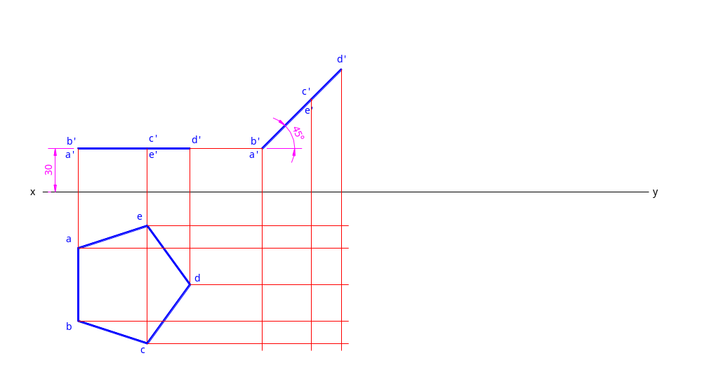
Example 3:
A regular pentagon of 50 mm side has its surface inclined to the H.P. at 45º and perpendicular to the V.P. One side of the pentagon is parallel to the H.P. and 30 mm above it. Draw its projections.

Slide 36

Example 3:
A regular pentagon of 50 mm side has its surface inclined to the H.P. at 45º and perpendicular to the V.P. One side of the pentagon is parallel to the H.P. and 30 mm above it. Draw its projections.

Slide 37
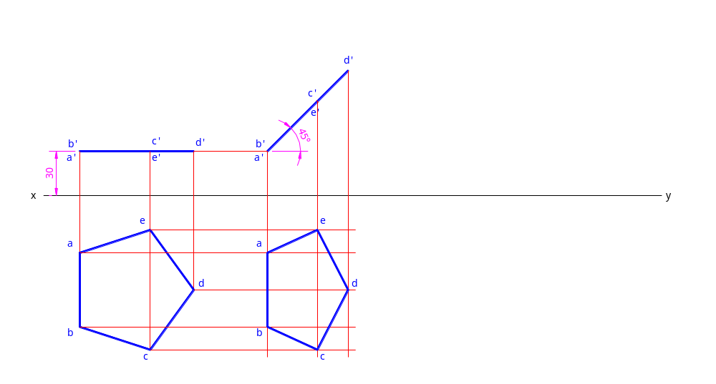
Example 3:
A regular pentagon of 50 mm side has its surface inclined to the H.P. at 45º and perpendicular to the V.P. One side of the pentagon is parallel to the H.P. and 30 mm above it. Draw its projections.

Slide 38
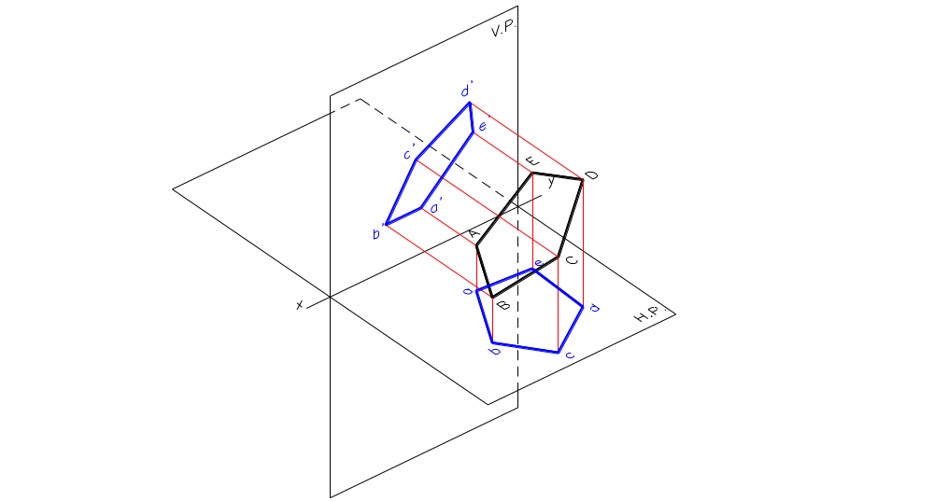
Inclined to both the Planes
  Top view is a deformed shape
  Front view is a deformed shape

Slide 39
Assume the plane to be perpendicular to the V.P. and inclined to the H.P. initially
  Top view will become deformed shape
  Front view shall become a straight line parallel to xy.

Slide 40
Further assume the plane to be parallel to H.P. initially
  Top view will become True size and shape and shall be drawn first.
  Front view is a straight line parallel to xy, the length of which will be the final length of front view.

Slide 41
Example 4:
A regular pentagon of 50 mm side has its surface inclined to the H.P. at 45º. One side of the pentagon is parallel to the H.P. and 30 mm above it and also inclined at 60º to the V.P. Draw its projections.

Slide 42
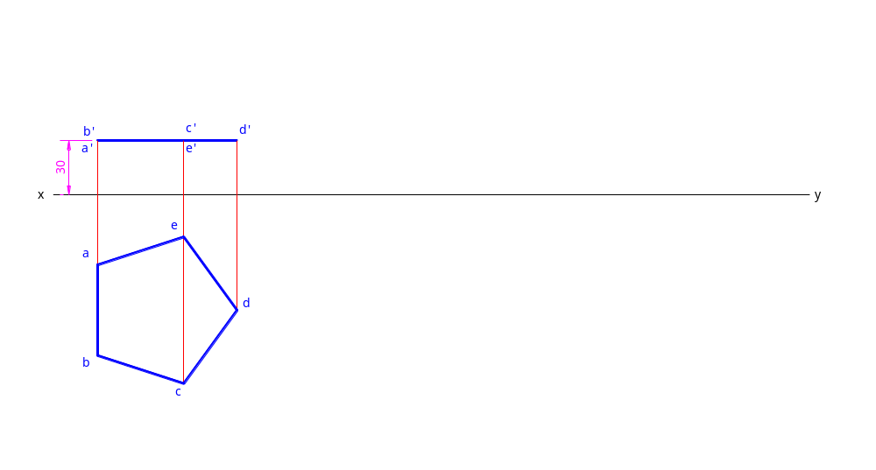
Example 4:
A regular pentagon of 50 mm side has its surface inclined to the H.P. at 45º. One side of the pentagon is parallel to the H.P. and 30 mm above it and also inclined at 60º to the V.P. Draw its projections.

Slide 43
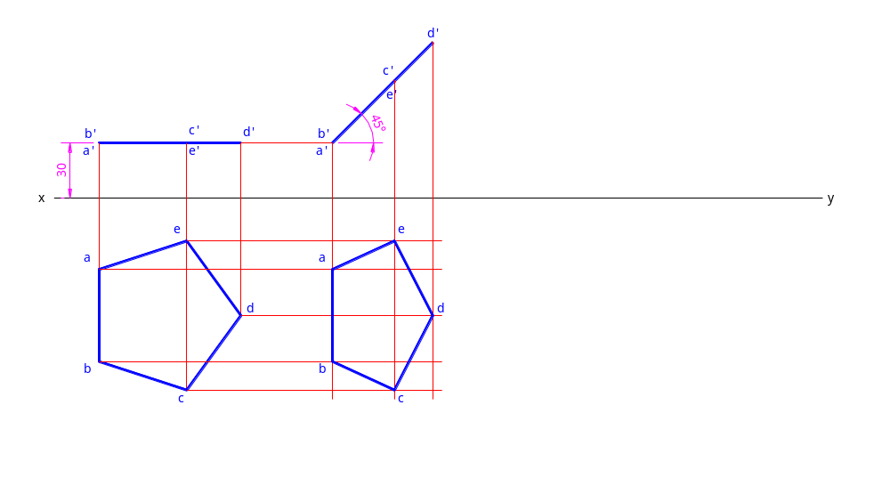
Example 4:
A regular pentagon of 50 mm side has its surface inclined to the H.P. at 45º. One side of the pentagon is parallel to the H.P. and 30 mm above it and also inclined at 60º to the V.P. Draw its projections.

Slide 44
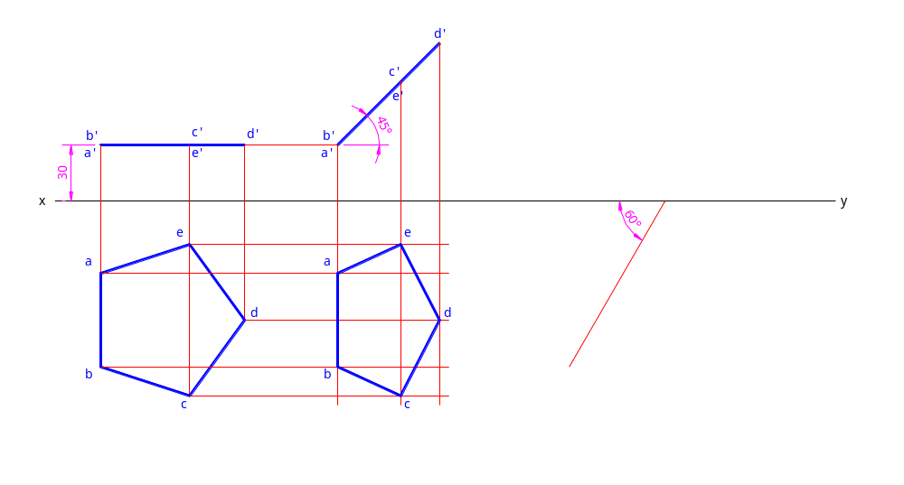
Example 4:
A regular pentagon of 50 mm side has its surface inclined to the H.P. at 45º. One side of the pentagon is parallel to the H.P. and 30 mm above it and also inclined at 60º to the V.P. Draw its projections.

Slide 45
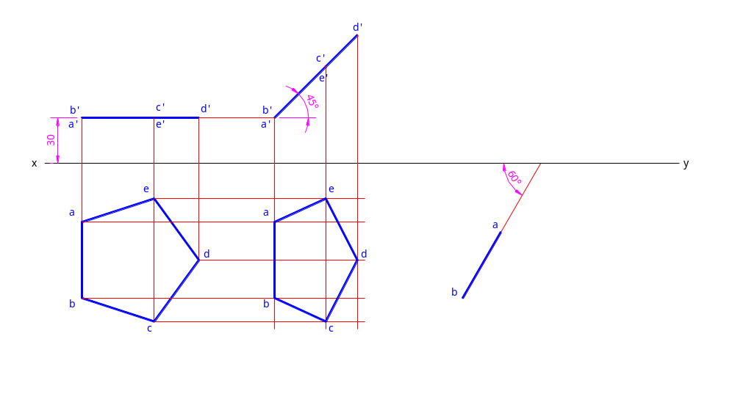
Example 4:
A regular pentagon of 50 mm side has its surface inclined to the H.P. at 45º. One side of the pentagon is parallel to the H.P. and 30 mm above it and also inclined at 60º to the V.P. Draw its projections.

Slide 46

Example 4:
A regular pentagon of 50 mm side has its surface inclined to the H.P. at 45º. One side of the pentagon is parallel to the H.P. and 30 mm above it and also inclined at 60º to the V.P. Draw its projections.

Slide 47
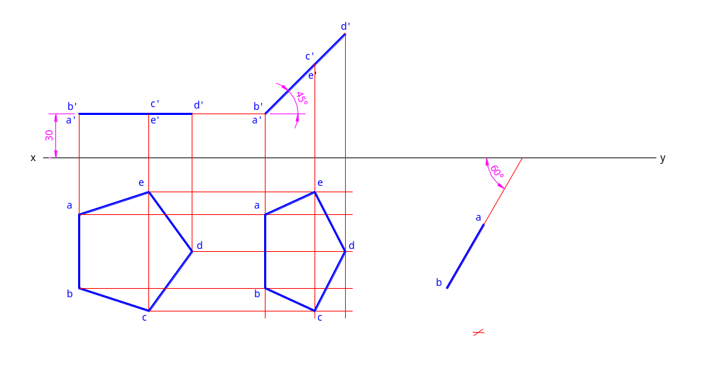
Example 4:
A regular pentagon of 50 mm side has its surface inclined to the H.P. at 45º. One side of the pentagon is parallel to the H.P. and 30 mm above it and also inclined at 60º to the V.P. Draw its projections.

Slide 48

Example 4:
A regular pentagon of 50 mm side has its surface inclined to the H.P. at 45º. One side of the pentagon is parallel to the H.P. and 30 mm above it and also inclined at 60º to the V.P. Draw its projections.

Slide 49
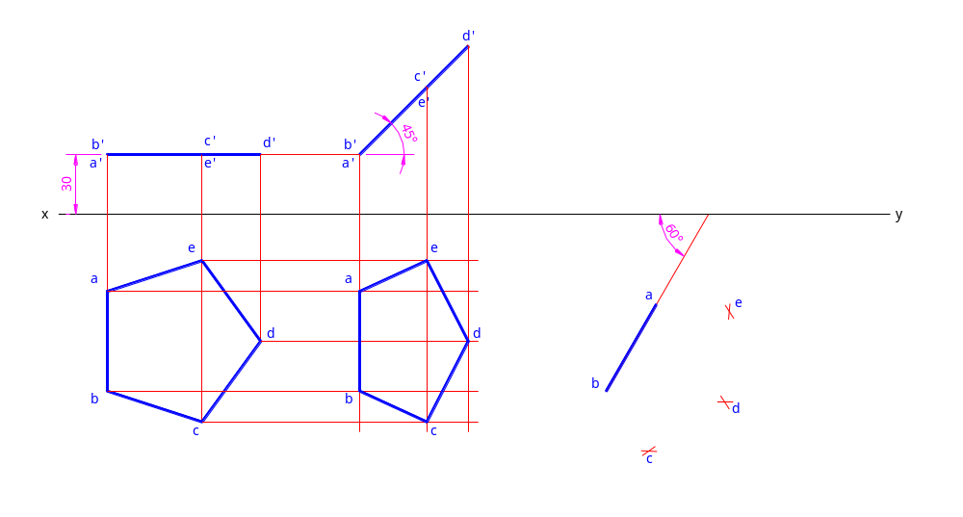
Example 4:
A regular pentagon of 50 mm side has its surface inclined to the H.P. at 45º. One side of the pentagon is parallel to the H.P. and 30 mm above it and also inclined at 60º to the V.P. Draw its projections.

Slide 50
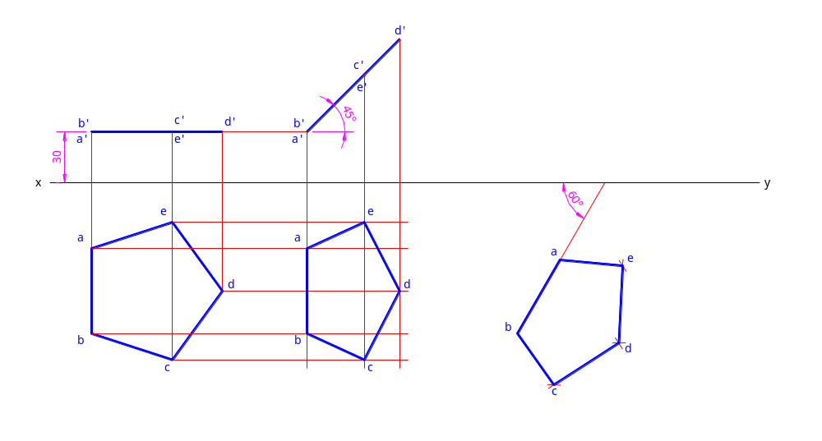
Example 4:
A regular pentagon of 50 mm side has its surface inclined to the H.P. at 45º. One side of the pentagon is parallel to the H.P. and 30 mm above it and also inclined at 60º to the V.P. Draw its projections.

Slide 51
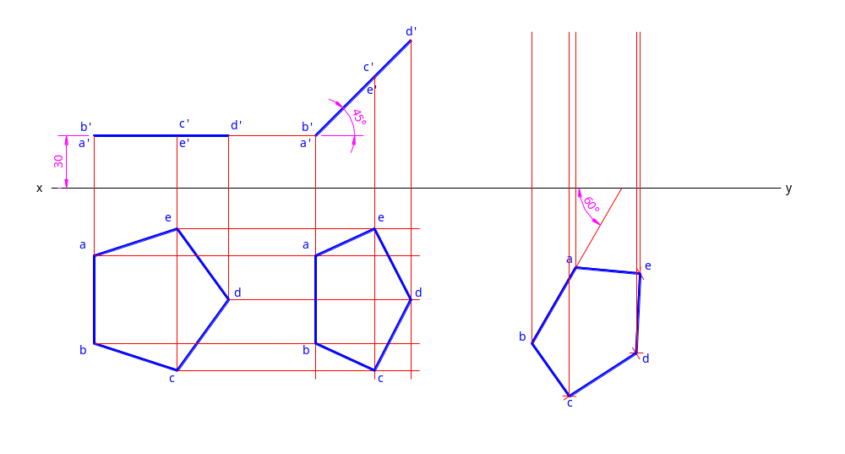
Example 4:
A regular pentagon of 50 mm side has its surface inclined to the H.P. at 45º. One side of the pentagon is parallel to the H.P. and 30 mm above it and also inclined at 60º to the V.P. Draw its projections.

Slide 52
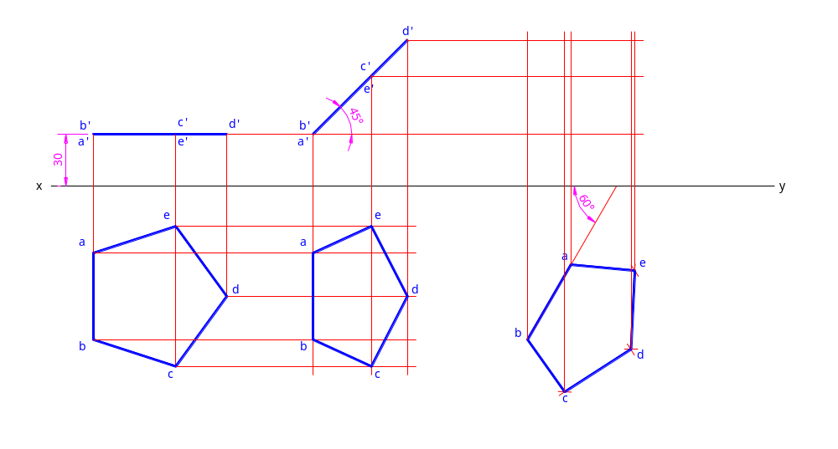
Example 4:
A regular pentagon of 50 mm side has its surface inclined to the H.P. at 45º. One side of the pentagon is parallel to the H.P. and 30 mm above it and also inclined at 60º to the V.P. Draw its projections.

Slide 53

Example 4:
A regular pentagon of 50 mm side has its surface inclined to the H.P. at 45º. One side of the pentagon is parallel to the H.P. and 30 mm above it and also inclined at 60º to the V.P. Draw its projections.

Slide 54
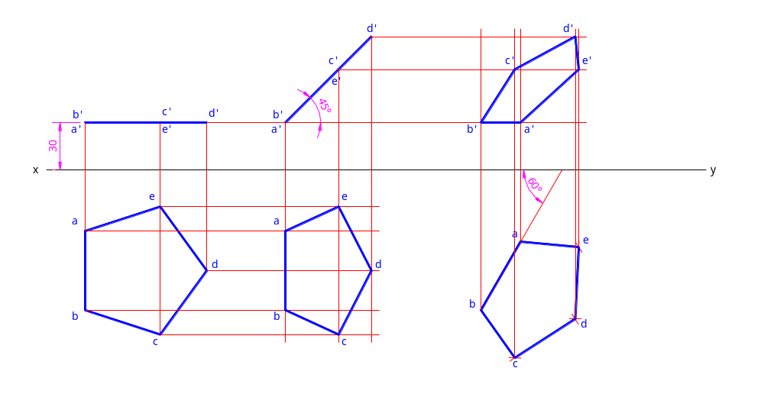
Example 4:
A regular pentagon of 50 mm side has its surface inclined to the H.P. at 45º. One side of the pentagon is parallel to the H.P. and 30 mm above it and also inclined at 60º to the V.P. Draw its projections.

Slide 55
Example 5:
A regular pentagon of 50 mm side has its surface inclined to the H.P. at 45º. One side of the pentagon is parallel to the H.P. and 30 mm above it. The top view of the line joining the mid-point of the parallel side to the opposite corner is inclined at 30º to the V.P. Draw its projections.

Slide 56

Example 5:
A regular pentagon of 50 mm side has its surface inclined to the H.P. at 45º. One side of the pentagon is parallel to the H.P. and 30 mm above it. The top view of the line joining the mid-point of the parallel side to the opposite corner is inclined at 30º to the V.P. Draw its projections.

Slide 57
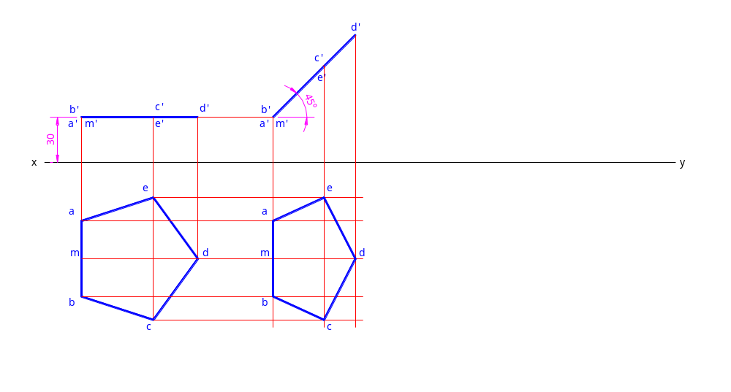
Example 5:
A regular pentagon of 50 mm side has its surface inclined to the H.P. at 45º. One side of the pentagon is parallel to the H.P. and 30 mm above it. The top view of the line joining the mid-point of the parallel side to the opposite corner is inclined at 30º to the V.P. Draw its projections.

Slide 58
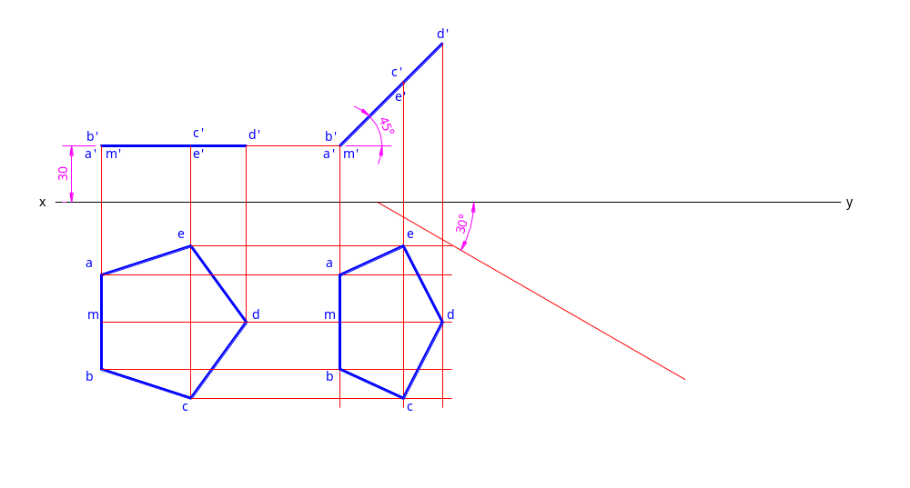
Example 5:
A regular pentagon of 50 mm side has its surface inclined to the H.P. at 45º. One side of the pentagon is parallel to the H.P. and 30 mm above it. The top view of the line joining the mid-point of the parallel side to the opposite corner is inclined at 30º to the V.P. Draw its projections.

Slide 59

Example 5:
A regular pentagon of 50 mm side has its surface inclined to the H.P. at 45º. One side of the pentagon is parallel to the H.P. and 30 mm above it. The top view of the line joining the mid-point of the parallel side to the opposite corner is inclined at 30º to the V.P. Draw its projections.

Slide 60
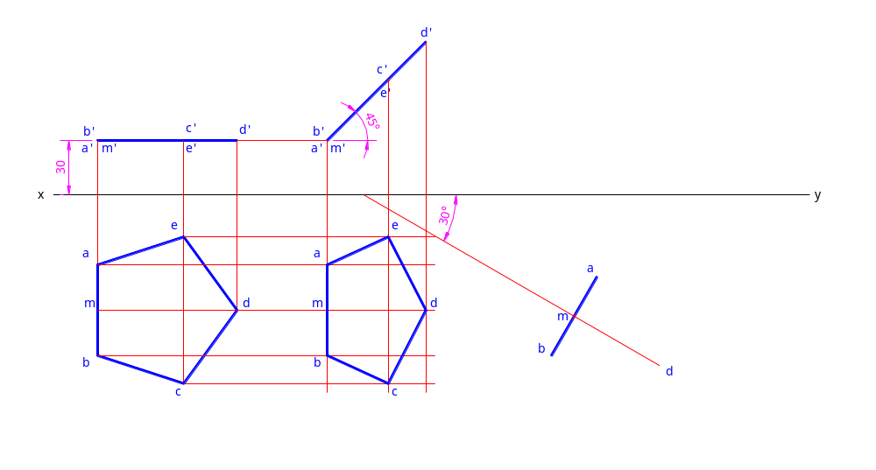
Example 5:
A regular pentagon of 50 mm side has its surface inclined to the H.P. at 45º. One side of the pentagon is parallel to the H.P. and 30 mm above it. The top view of the line joining the mid-point of the parallel side to the opposite corner is inclined at 30º to the V.P. Draw its projections.

Slide 61
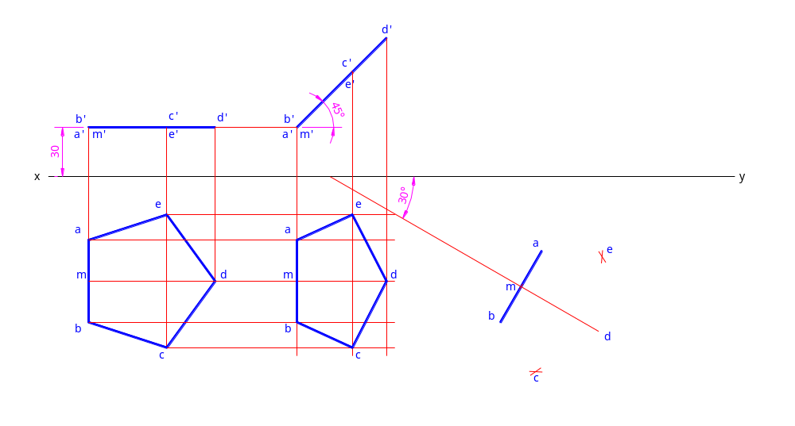
Example 5:
A regular pentagon of 50 mm side has its surface inclined to the H.P. at 45º. One side of the pentagon is parallel to the H.P. and 30 mm above it. The top view of the line joining the mid-point of the parallel side to the opposite corner is inclined at 30º to the V.P. Draw its projections.

Slide 62
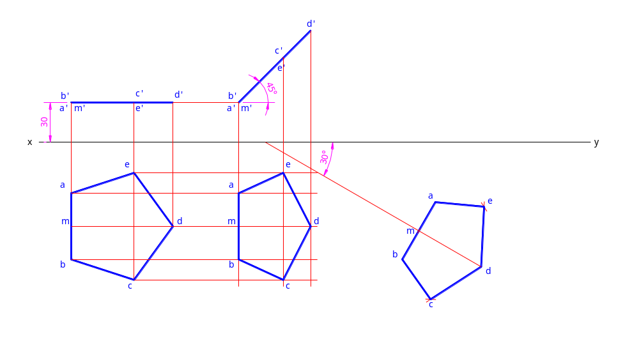
Example 5:
A regular pentagon of 50 mm side has its surface inclined to the H.P. at 45º. One side of the pentagon is parallel to the H.P. and 30 mm above it. The top view of the line joining the mid-point of the parallel side to the opposite corner is inclined at 30º to the V.P. Draw its projections.

Slide 63
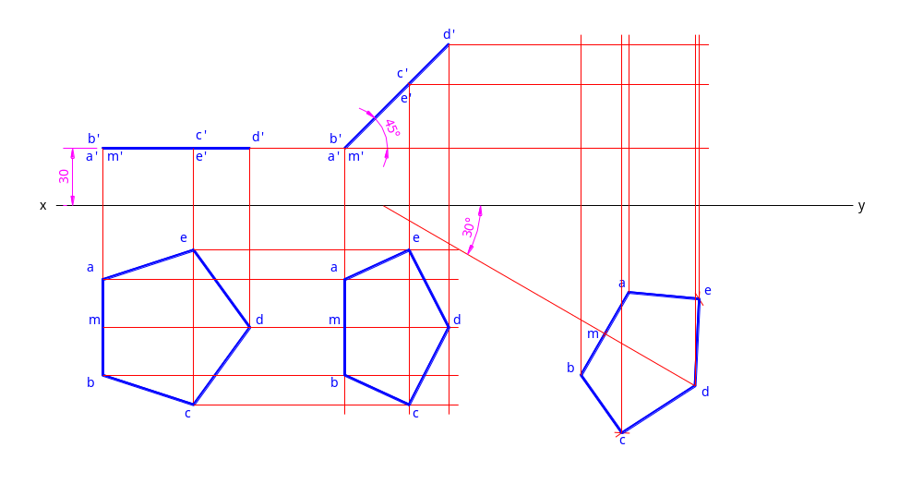
Example 5:
A regular pentagon of 50 mm side has its surface inclined to the H.P. at 45º. One side of the pentagon is parallel to the H.P. and 30 mm above it. The top view of the line joining the mid-point of the parallel side to the opposite corner is inclined at 30º to the V.P. Draw its projections.

Slide 64
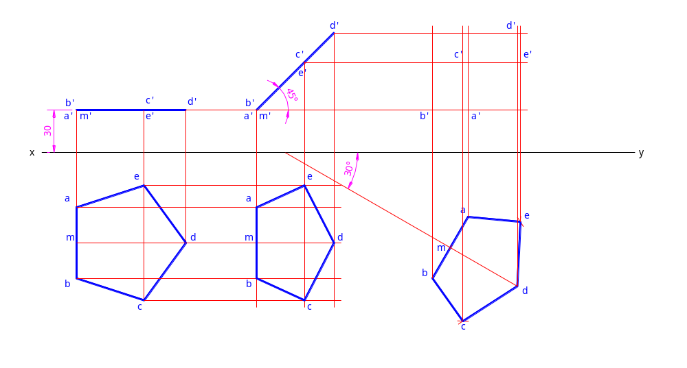
Example 5:
A regular pentagon of 50 mm side has its surface inclined to the H.P. at 45º. One side of the pentagon is parallel to the H.P. and 30 mm above it. The top view of the line joining the mid-point of the parallel side to the opposite corner is inclined at 30º to the V.P. Draw its projections.

Slide 65
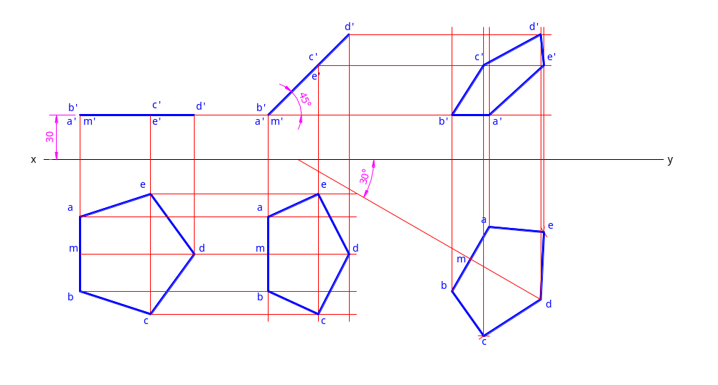
Example 5:
A regular pentagon of 50 mm side has its surface inclined to the H.P. at 45º. One side of the pentagon is parallel to the H.P. and 30 mm above it. The top view of the line joining the mid-point of the parallel side to the opposite corner is inclined at 30º to the V.P. Draw its projections.

Slide 66
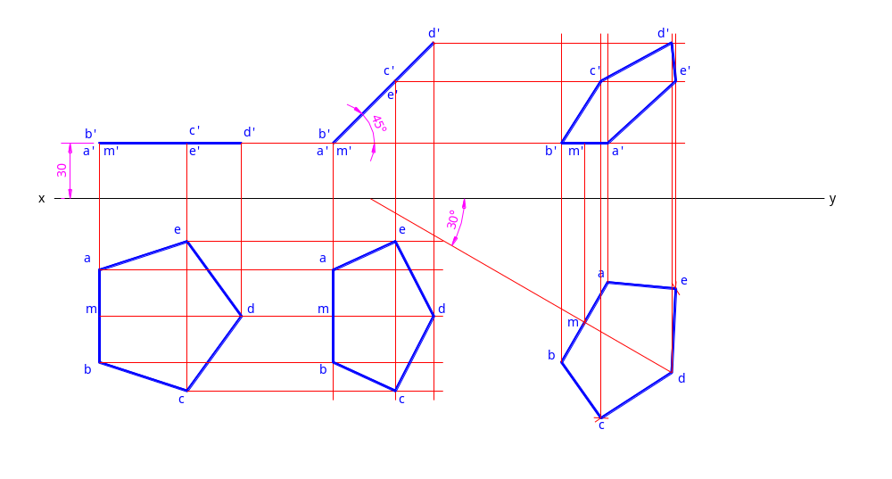
Example 5:
A regular pentagon of 50 mm side has its surface inclined to the H.P. at 45º. One side of the pentagon is parallel to the H.P. and 30 mm above it. The top view of the line joining the mid-point of the parallel side to the opposite corner is inclined at 30º to the V.P. Draw its projections.

Slide 67

Example 5:
A regular pentagon of 50 mm side has its surface inclined to the H.P. at 45º. One side of the pentagon is parallel to the H.P. and 30 mm above it. The top view of the line joining the mid-point of the parallel side to the opposite corner is inclined at 30º to the V.P. Draw its projections.

Slide 68
Thank You

